Slide 1


Department of Computer Science and Engineering
LUNG CANCER PREDICTION USING DECISION TREE CLASSIFIER ALGORITHM-SMLT
RAAGUL S (211419104206)
RAM KUMAR R (211419104216)
VINOTH KUMAR R (211419104307)
Guide Name & Designation
Coordinator Name & Designation

Slide 2
Abstract
The aim is to predict machine learning-based techniques for Lung cancer prediction results with the best Accuracy. The analysis of dataset by supervised machine learning technique (SMLT) to capture several information like, variable identification, univariate analysis, bi-variate, and multi-variate analysis, missing value treatments and analyze the data validation, data cleaning/preprocess and data visualization will be done on the entire given dataset. Additionally, to compare and discuss the performance of various machine learning algorithms from the given dataset with evaluation classification report, identify the confusion matrix, and to categorizing data from priority and the result shows that the effectiveness of the proposed machine learning algorithm technique can be compared with the best accuracy with precision, Recall and F1 Score.

Slide 3
Objective of the Project
The goal is to develop a machine learning model for lung cancer Prediction, to potentially replace the updatable data science techniques models by predicting results in the form of best accuracy by comparing data science algorithm.

Slide 4
Literature Survey
YEAR | AUTHOR(S) | PAPER TITLE | METHODOLOGY | MERITS/ DEMERITS | FUTURE SCOPE
2022 | Umair Khan , Federico Mento , Lucrezia Nicolussi Giacomaz, Riccardo Trevisan, Andrea Smargiassi, Riccardo Inchingolo , Tiziano Perrone, and Libertario Demi. | Deep Learning-Based Classification of Reduced Lung Ultrasound Data From COVID-19 Patients. Volume: 69 Issued on: March 23, 2022; Journal: IEEE Transactions on Ultrasonics , Ferroelectrics , and Frequency control | This study evaluates the performance of DL algorithm over LUS data with varying pixel and gray-level resolution. The CNN algorithm is used to evaluate over a dataset of 448 LUS videos captured from 34 examinations of 20 patients to predict lung cancer. | MERITS: The test shows a high rate of false negatives making it less suitable for the diagnosis DEMERITS: However, its high Cost, limited availability, and exposure of patients to radiations make it less preferable. | As a future work, it focus on evaluating our study on different DL algorithms and use this study as a benchmark for comparison of prediction performance on reduced LUS data.

Slide 5
Literature Survey
YEAR | AUTHOR(S) | PAPER TITLE | METHODOLOGY | MERITS/ DEMERITS | FUTURE SCOPE
2022 | Lal Hussain, Hadeel Alsolai. | Lung Cancer Prediction Using Robust Machine Learning and Image Enhancement Methods on Extracted Gray-Level Co-Occurrence Matrix Features. Volume: 12 Issued on : 27 June 2022; Journal:MDPI , Applied Science | This study aimed to improve lung cancer image quality by utilizing and employing various image enhancement methods, such as image adjustment, gamma correction, contrast stretching, thresholding, and histogram equalization methods. | MERITS: It distinguish between the groups of NSCLC and SCLC by first extracting hand-crafted texture features and employing supervised machine learning algorithms. DEMERITS: The present study was carried out on a small lung cancer dataset provided by the Lung Cancer Alliance on lung cancer types, i.e., NSCLC and SCLC. | In the future, we shall apply the proposed methods based on image enhancement, feature extraction, and ranking and machine learning methods on larger datasets with more clinical details, disease severity levels, and more types, and larger datasets acquired on different imaging modalities.

Slide 6
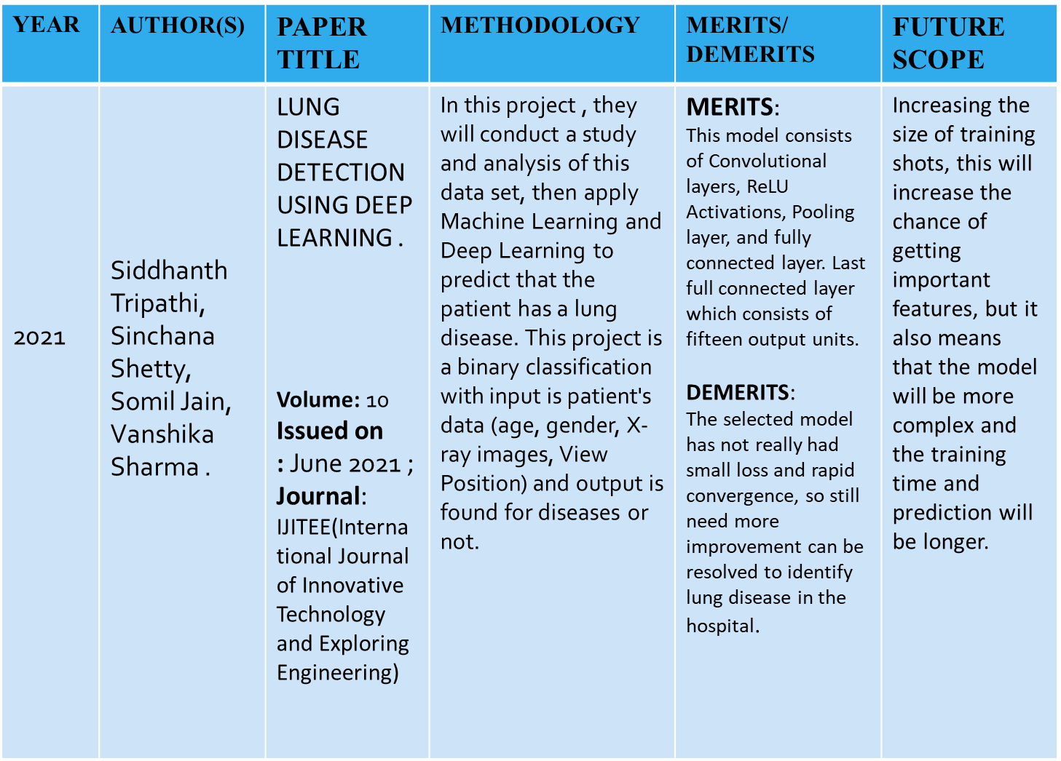
Literature Survey

Slide 7
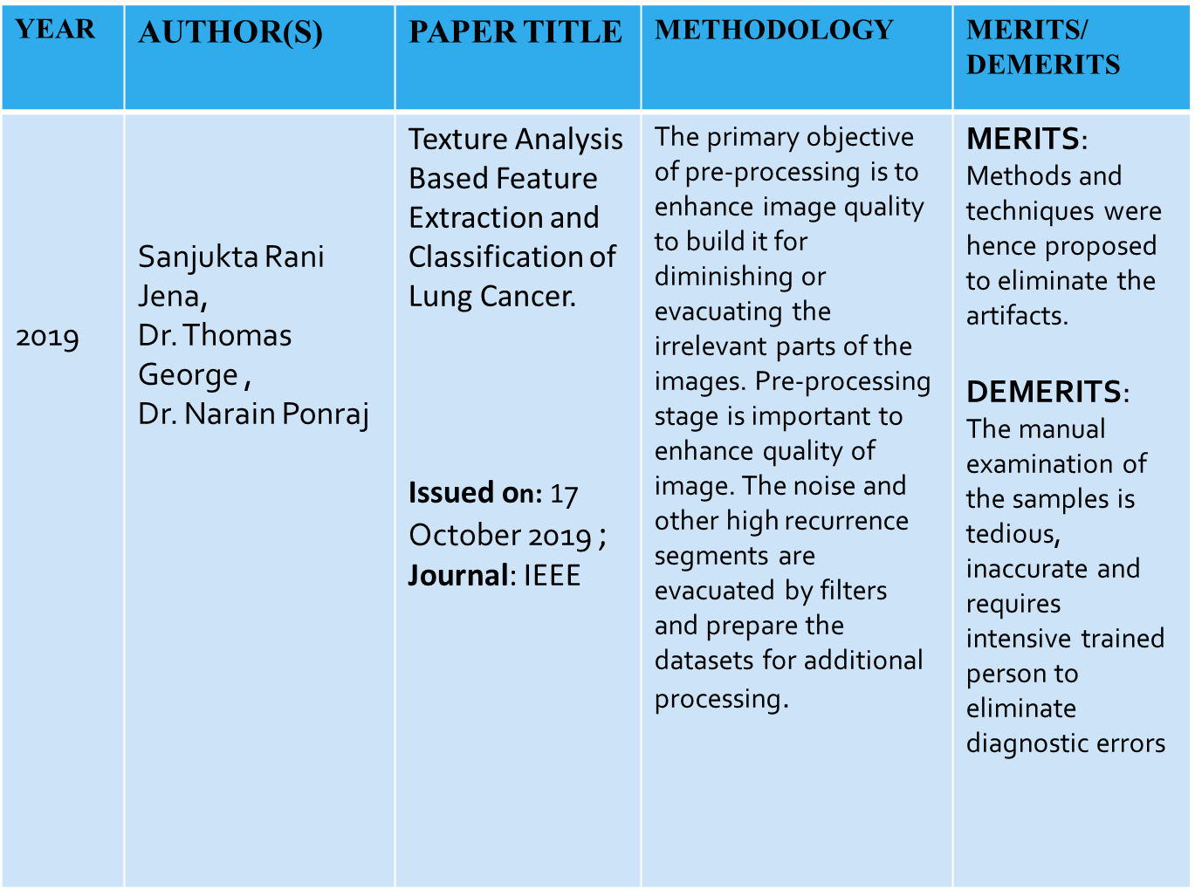
Literature Survey

Slide 8
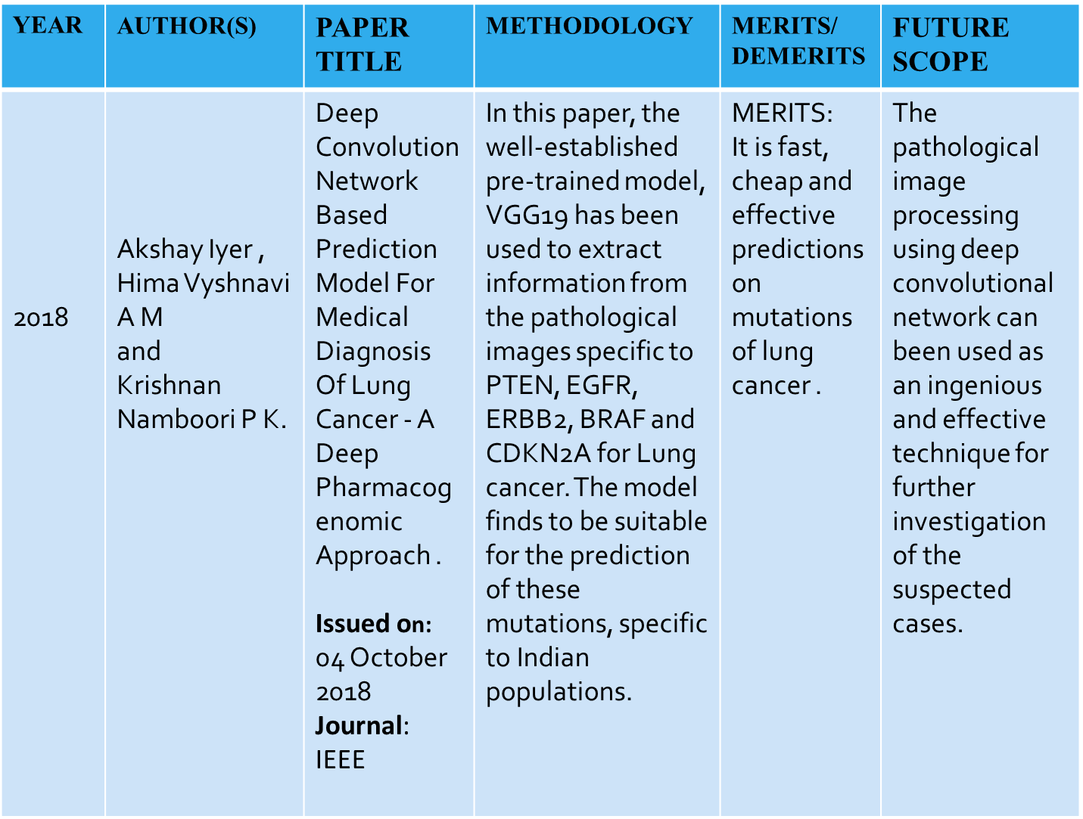
Literature Survey

Slide 9
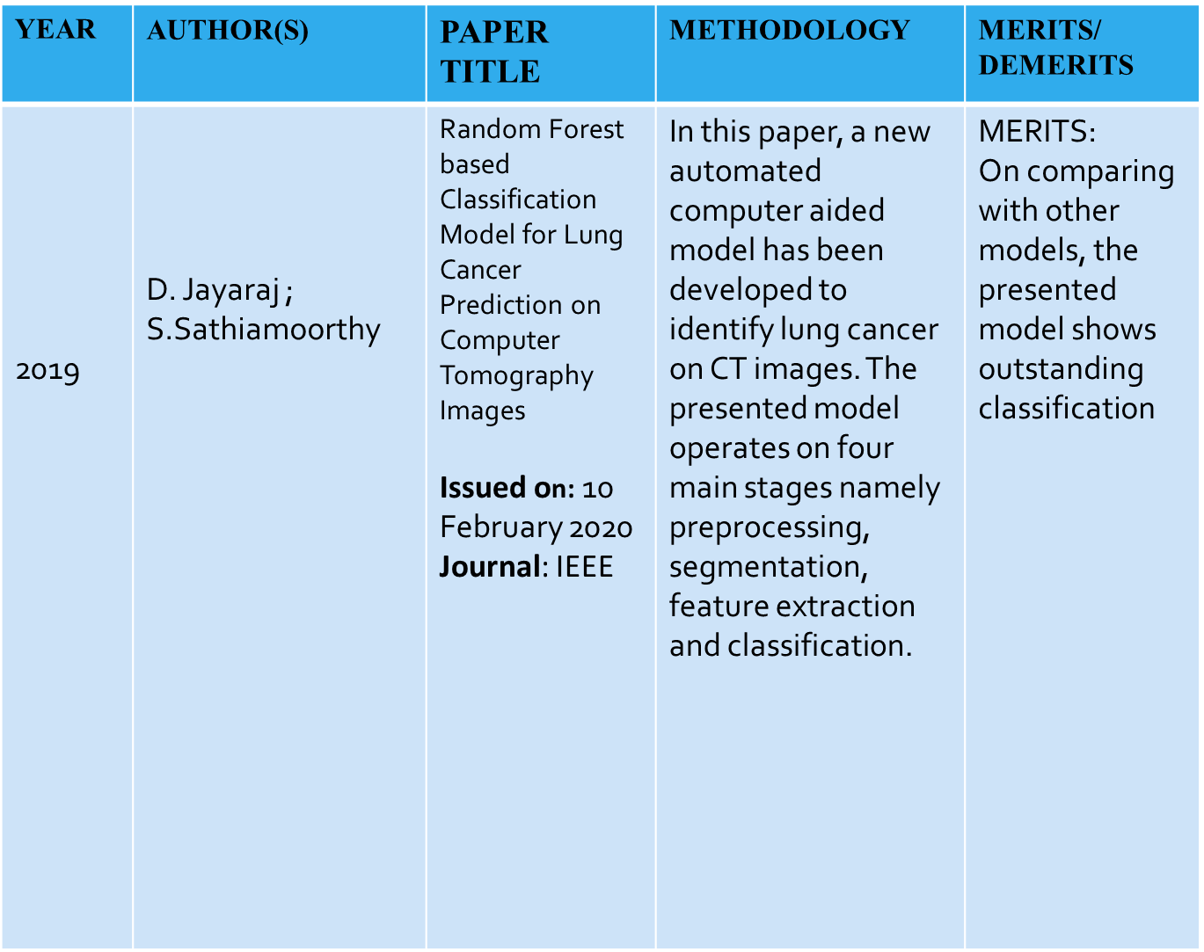
Literature Survey

Slide 10
Existing System
The application of lung ultrasound (LUS) imaging for the diagnosis of lung diseases has recently captured significant interest within the research community. With the ongoing COVID-19 pandemic, many efforts have been made to evaluate LUS data. A four-level scoring system has been introduced to semi quantitatively assess the state of the lung, classifying the patients. This evaluates the performance using CNN algorithm over LUS data with varying pixel and gray-level resolution by Deep Learning.

Slide 11
Proposed System
In our proposed system we have used machine learning algorithm for implementation. In this model, Decision tree classifier is used for the deployment in order to predict the output. So, basically this proposed model can be accessed by anyone at any time in order to find out whether they are affected by lung cancer or not. For the betterment of the usage we have created a user interface, where the user can update about their health status and can get to know whether they are affected by lung cancer or not.

Slide 12
Software / Hardware used
Software Requirements:
Operating System : Windows 10 or later
Tool : Anaconda with Jupyter Notebook
Hardware requirements:
Processor : Intel i3
Hard disk : minimum 10 GB
RAM : minimum 4 GB

Slide 13
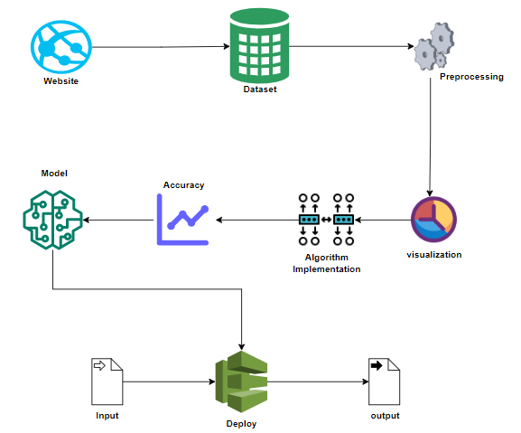
System Architecture

Slide 14
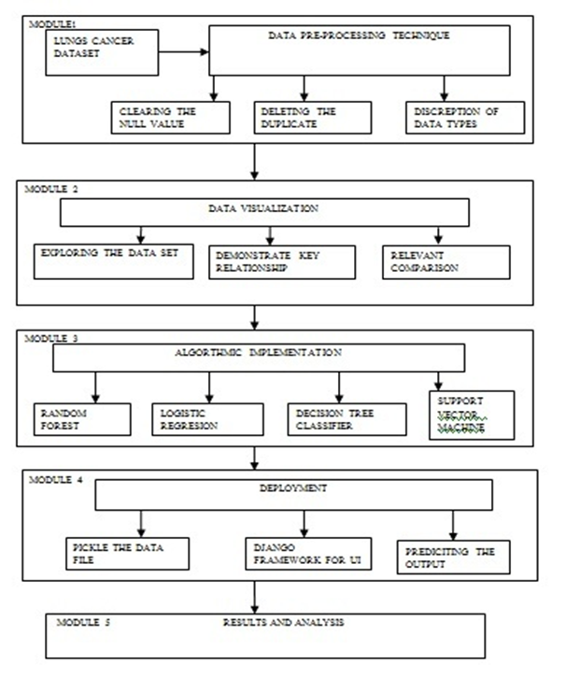
System Design-Block Diagram

Slide 15
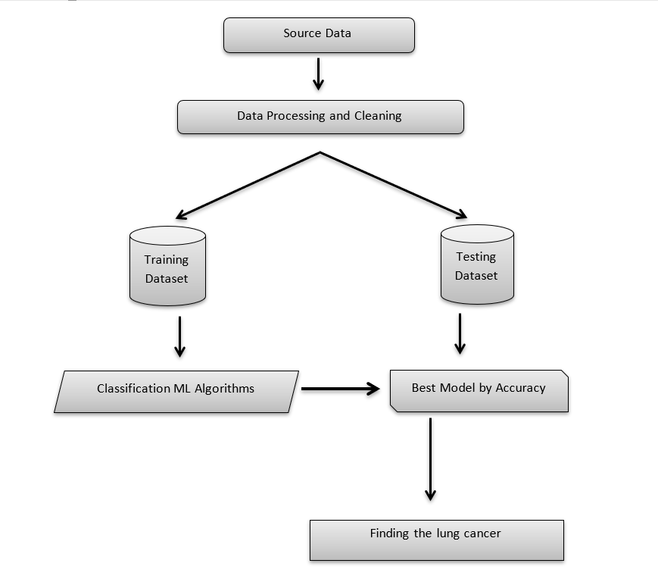
System Design-Data Workflow Diagram

Slide 16
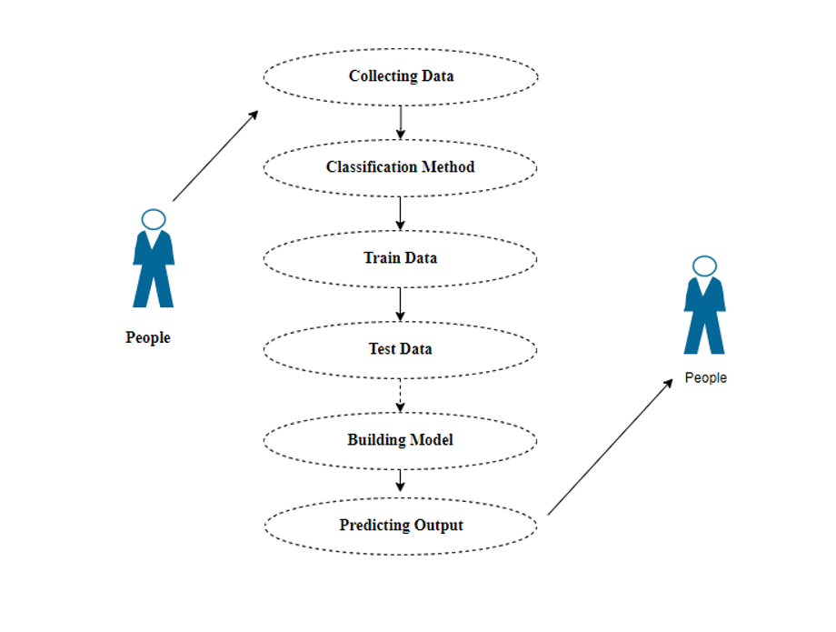
System Design-Use-Case Diagram

Slide 17
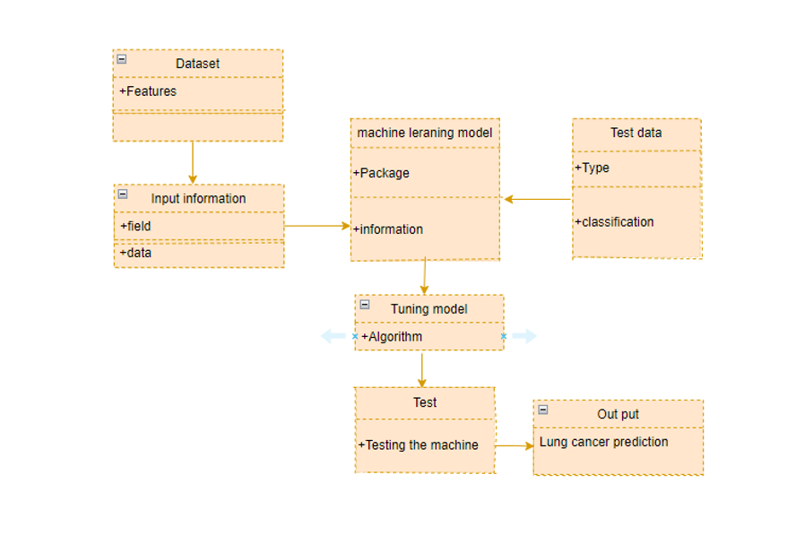
System Design-Class Diagram

Slide 18
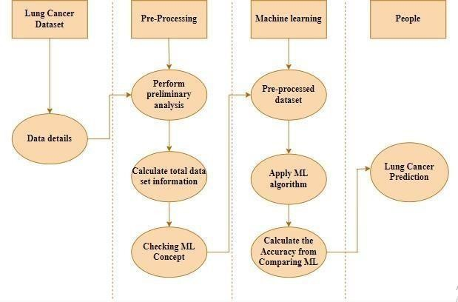
System Design –Activity Diagram

Slide 19
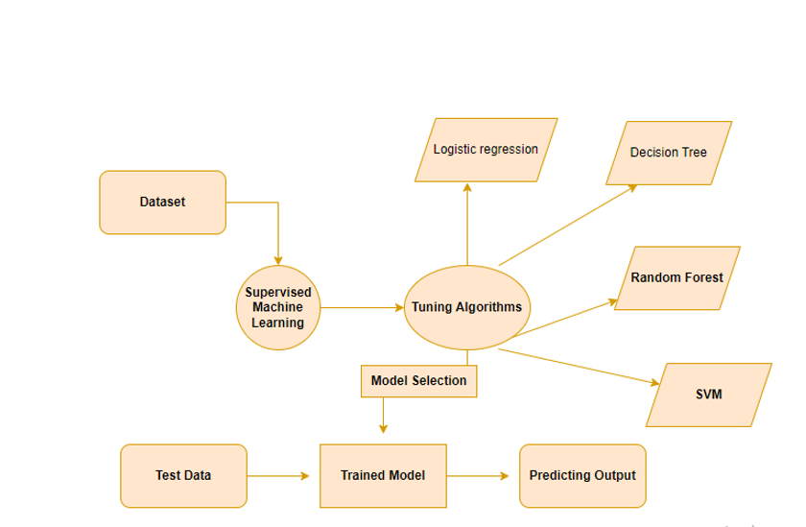
System Design – ER Diagram

Slide 20
Methodology used
Data Pre-processing
Data Analysis of Visualization
Implementing Algorithm 1
Logistic Regression
Implementing Algorithm 2
Decision Tree
Implementing Algorithm 3
Random Forest
Implementing Algorithm 4
Support vector Machine
Deployment

Slide 21
Module Description
MODULE 1 : Data Pre-processing
Validation techniques in machine learning are used to get the error rate of the Machine Learning (ML) model, which can be considered as close to the true error rate of the dataset. In real-world scenarios, to work with samples of data that may not be a true representative of the population of given dataset. To finding the missing value, duplicate value and description of data type whether it is float variable or integer. The sample of data used to provide an unbiased evaluation of a model fit on the training dataset while tuning model hyper parameters.

Slide 22
Module Description
Module 2: Virtualization
Data visualization is an important skill in applied statistics and machine learning. Statistics does indeed focus on quantitative descriptions and estimations of data. Data visualization provides an important suite of tools for gaining a qualitative understanding. This can be helpful when exploring and getting to know a dataset and can help with identifying patterns, corrupt data, outliers, and much more.

Slide 23
Module Description
Logistic Regression Algorithm:
It is a statistical method for analyzing a data set in which there are one or more independent variables that determine an outcome. The outcome is measured with a dichotomous variable.
The goal of logistic regression is to find the best fitting model to describe the relationship between the dichotomous characteristic of interest and a set of independent variables.
Logistic regression is a Machine Learning classification algorithm that is used to predict the probability of a categorical dependent variable. In logistic regression, the dependent variable is a binary variable that contains data coded as 1 (yes) or 0 (no).

Slide 24
Module Description
Decision Tree Classifier Algorithm:
Decision tree learning is a supervised learning approach used in statistics, datamining and machine learning.
Tree models where the target variable can take a discrete set of values are called classification trees; in these tree structures, leaves represent class labels and branches represent conjunctions of features that lead to those class labels.
Decision trees where the target variable can take continuous values are called regression trees.

Slide 25
Module Description
Random Forest Algorithm:
Random forest is a type of supervised machine learning algorithm based on ensemble learning.
Ensemble learning is a type of learning where you join different types of algorithms or same algorithm multiple times to form a more powerful prediction model.
The random forest algorithm can be used for both regression and classification tasks.

Slide 26
Module Description
Support Vector Machine Algorithm:
Support Vector Machine or SVM is one of the most popular Supervised Learning algorithms, which is used for Classification as well as Regression problems.
The goal of the SVM algorithm is to create the best line or decision boundary that can segregate n-dimensional space into classes.
SVM chooses the extreme vectors that help in creating the hyperplane. These extreme cases are called as support vectors.

Slide 27
Module Description
Module 4: Deployment
In this module the trained machine learning model is converted into pickle data format file (.pkl file) which is then deployed in our django framework for providing better user interface and predicting the output of given data is lung cancer prediction.

Slide 28
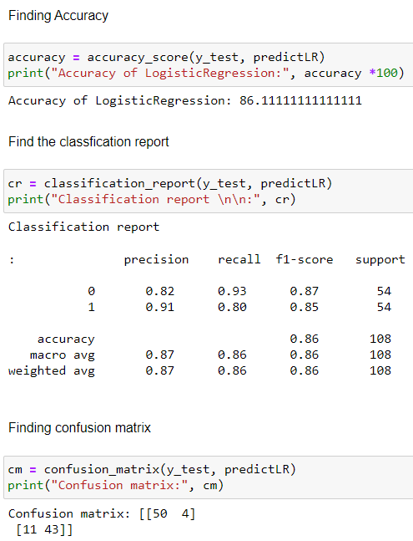
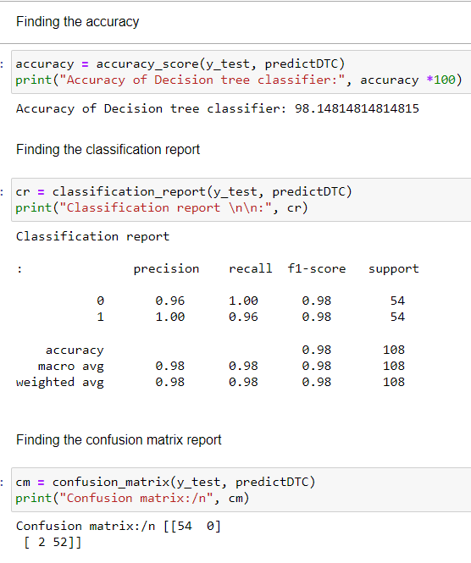
Performance Evaluation
Logistic Regression
Decision Tree

Slide 29
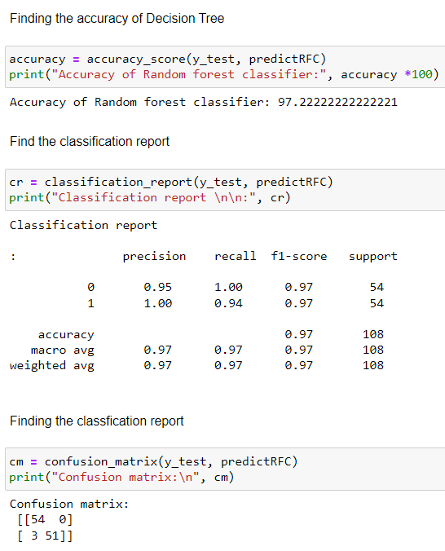
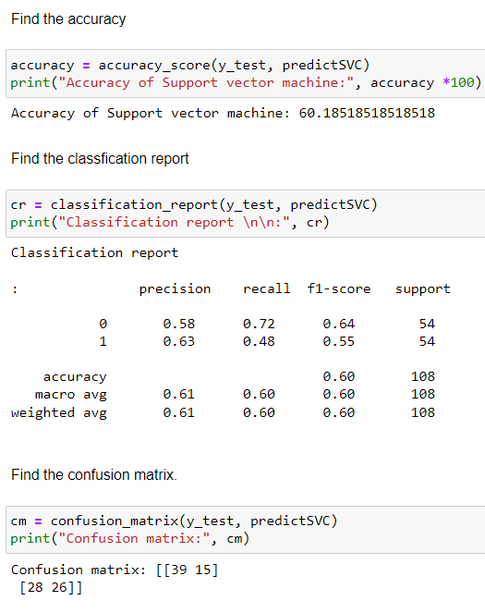
Performance Evaluation
Random Forest
Support Vector Machine

Slide 30
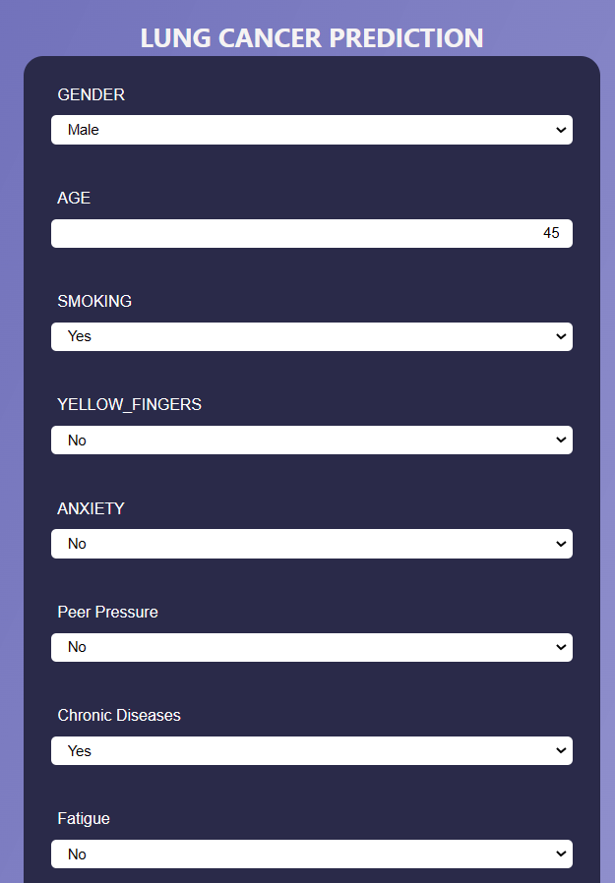
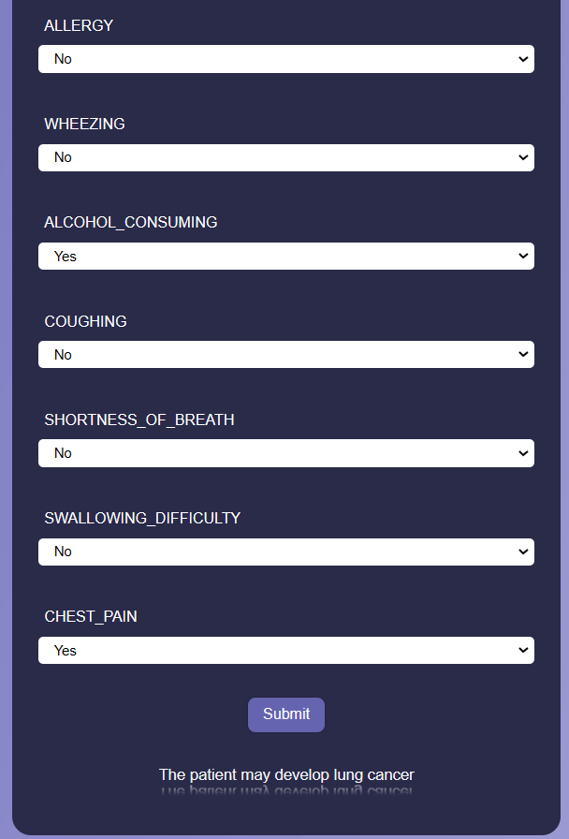
Screen Shots
Prediction 1:

Slide 31
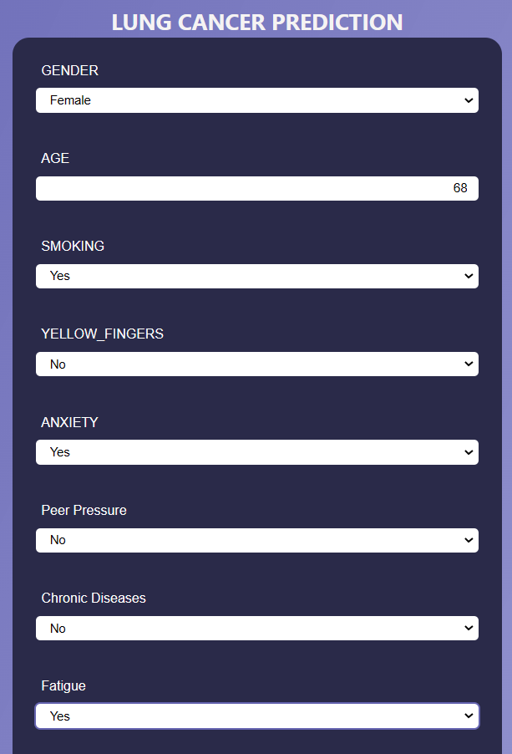
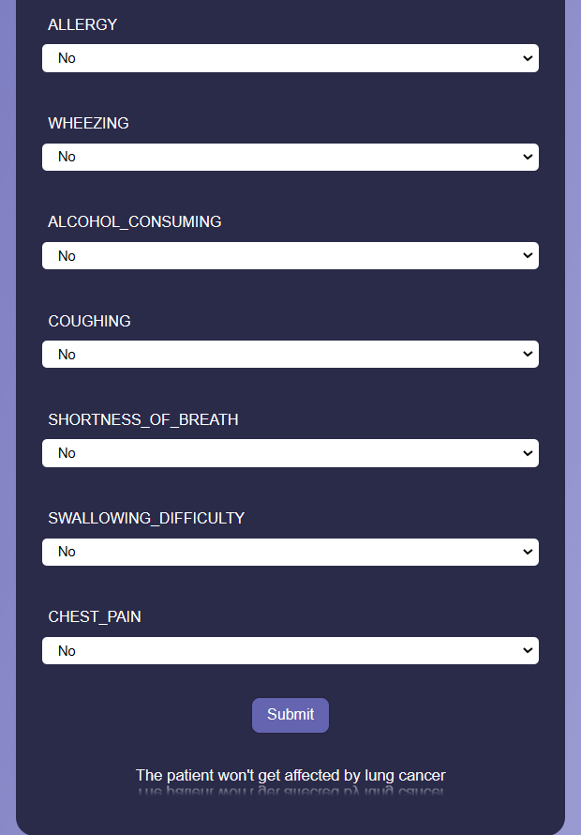
Screen Shots
Prediction 2:

Slide 32
Conclusion
In Our project, the analytical process started from data cleaning by data Pre- processing technique and processing and visualizing our collected data set, missing value, exploratory analysis and finally model building and evaluation.
The best accuracy on public test set of higher accuracy score algorithm will be find out. By comparing the results and accuracy score we got from all 4 algorithms, in most cases our best accuracy with sample data set is Decision tree classifier Algorithm.
This Algorithm’s higher accuracy score is 98.2%. Which is way higher than CNN Algorithm which was used in the existing system. Decision Tree classifier is used in the application which can help to find the lung cancer prediction.

Slide 33
Future Work
Deploying the project in the cloud.
To optimize the work to implement in the IOT system.

Slide 34
Reference Paper
[1] Siegel, R.L.; Miller, K.D.; Jemal, A. Cancer statistics, 2018. CA. Cancer J. Clin. 2018, 68, 7–30.
[2] Oser, M.G.; Niederst, M.J.; Sequist, L.V.; Engelman, J.A. Transformation from non-small-cell lung cancer to small-cell lung cancer: Molecular drivers and cells of origin. Lancet Oncol. 2015, 16, e165–e172.
[3] Eng. Technol. 2009, 3, 942–947. 35. Nithya, R.; Santhi, B. Classification of Normal and Abnormal Patterns in Digital Mammograms for Diagnosis of Breast Cancer. Int. J. Comput. Appl. 2011, 28, 975–8887.
[4] Xiao S, Lux ML, Reeves R, Hudson TJ, Fletcher JA. HMGI(Y) activation by chromosome 6p21 rearrangements in multilineage mesenchymal cells from pulmonary hamartoma. Am J Pathol 1997;150:901–910.
[5] Murat Karabhatak, M.Cevdet Ince 2008. Expert system for detection of breast cancer based on association rules and neural network. Journal: Expert systems with Applications .

Slide 35
Reference Paper
[6] Travis WD, Brambilla E, Burke AP, Marx A, Nicholson AG. WHO Classification of Tumours of the Lung, Pleura, Thymus and Heart. Lyon: International Agency for Research on Cancer, 2015
[7] Rekhtman N, Ang DC, Sima CS, et al. Immunohistochemical algorithm for differentiation of lung adenocarcinoma and squamous cell carcinoma based on large series of whole-tissue sections with validation in small specimens. Mod Pathol 2011;24(10):1348–59.
[8] Forum of International Respiratory Societies. The Global Impact of Respiratory Disease, 2nd ed.; European Respiratory Society, Sheffield, UK, 2017; pp. 5–42. © 2021 JETIR May 2021, Volume 8, Issue 5 www.jetir.org (ISSN-2349-5162) JETIR2105898 Journal of Emerging Technologies and Innovative Research (JETIR)
[9] Hu, Z.; Tang, J.; Wang, Z.; Zhang, K.; Zhang, L.; Sun, Q. Deep learning for image-based cancer detection and diagnosis-A survey. Pattern Recognit. 2018, 83, 134–149.
[10] Wu, C.; Luo, C.; Xiong, N.; Zhang, W.; Kim, T.H. A Greedy Deep Learning Method for Medical Disease Analysis. IEEE Access 2018, 6, 20021–20030.

